Slide 1
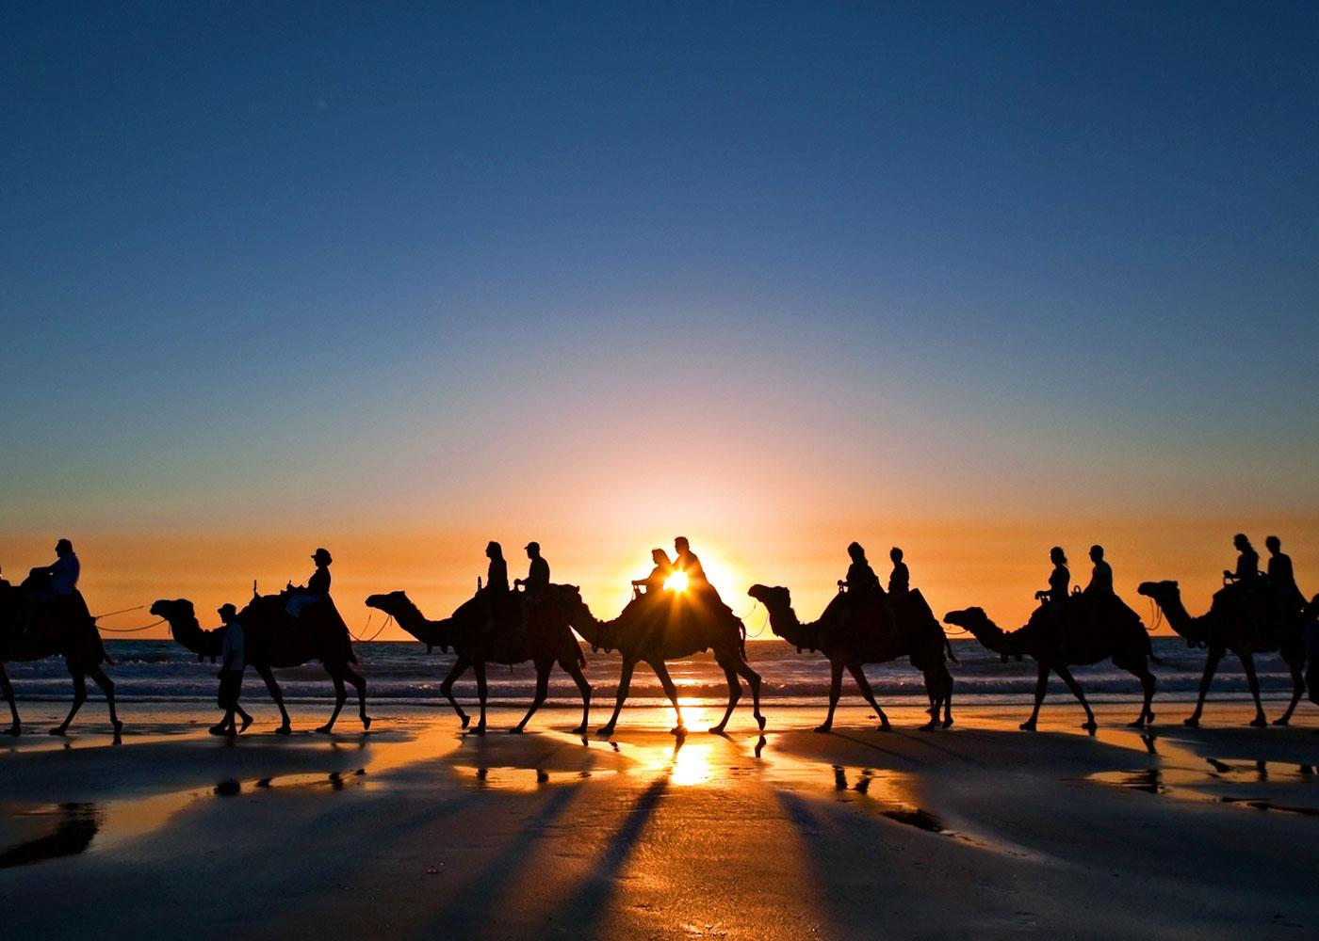
SMART-GAT
Tourism Made Easier

Slide 2
Content
Idea
Problems that needs solution
System Design
Analysis Case Studies
Future Scope
References

Slide 3
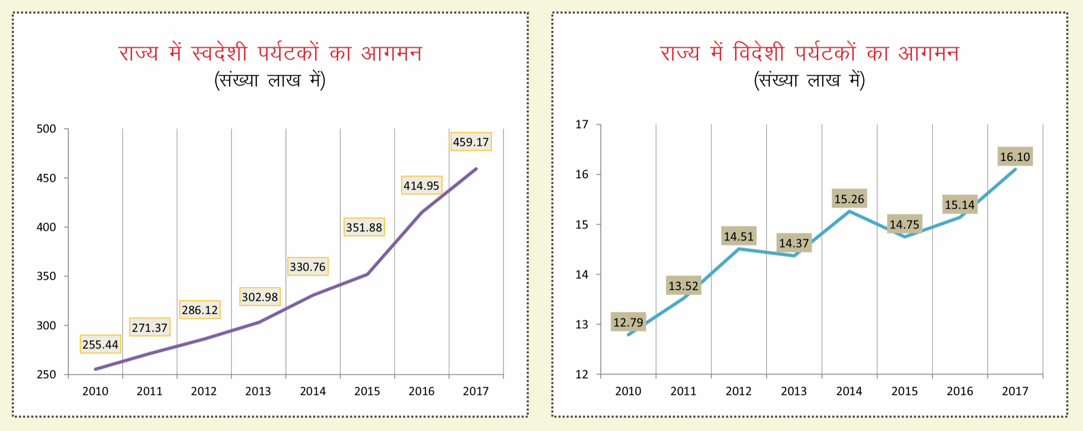
Rajasthan Current Tourism
Tourism accounts for ~15 % of Rajasthan’s economy
Rajasthan Tourism accounts for 2.7 % in Gross State Domestic Product and 1.9 % in State Employment
[2] http://tourism.rajasthan.gov.in/content/dam/rajasthan-tourism/english/others/tourism-department-annual-progress-report-2017-18.pdf

Slide 4
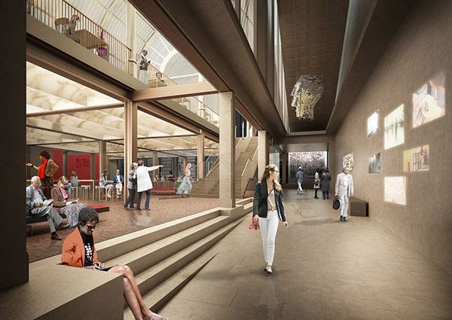
Available Guide Systems
Tourist Guides
Fontane monument’s Description
Google Maps and Navigation
Virtual 360º Viewer

Slide 5
Features of Legacy Guide Systems
Tourist Guides | Fontane Description | Google Maps | Virtual 360º
Inaccurate Information | Brief Information-remains Constant | No Access at remote areas | Virtual
Expensive | Single Language | - | No Access at remote areas
Communication Gaps | Unexciting and Boring | - | -
1 is to Many | Updating of Research is Difficult | - | -

Slide 6
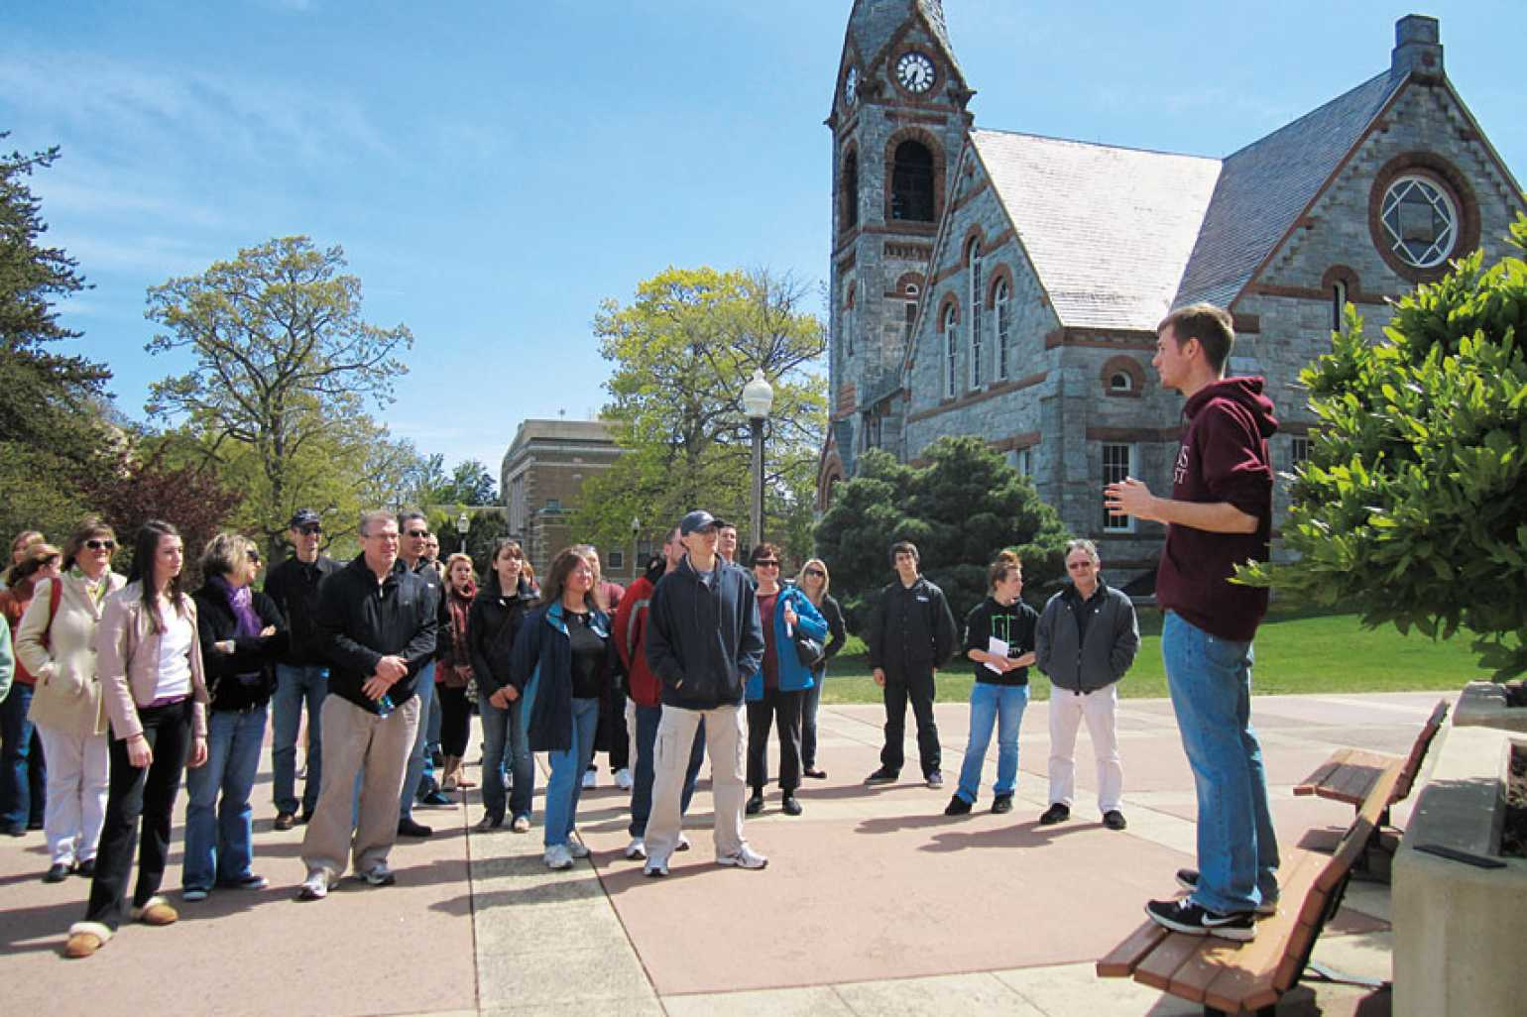
Smart-GAT Idea✌️
GAT- self Guided Automated system for Tourist
1 to 1 Smart Guide for every Tourist anytime
Intricate and genuine details of the any Ancient building, sculpture or painting
Accessible at Remote areas, where there is no Internet connectivity
Open as well Indoor navigation system
[1] https://www.umass.edu/gateway/visit

Slide 7
Implementation of Idea
Hardware as well as Software based
Raspberry Pie
QR- Code Scanning
Real-Time Information in Text as well as Speech
Dependent on language selected
Indoor Navigation System

Slide 8
Component Used
Raspberry Pi
LCD Touch Screen
Audio Amplifier
Wires
Pi-Camera
Power Supply

Slide 9
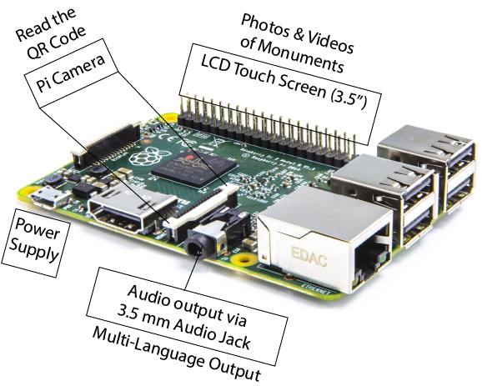
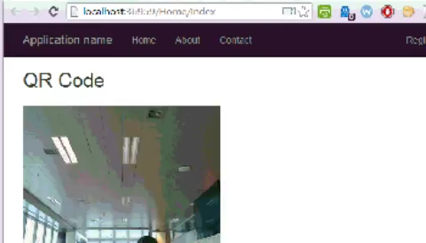
Smart-GAT System

Slide 10
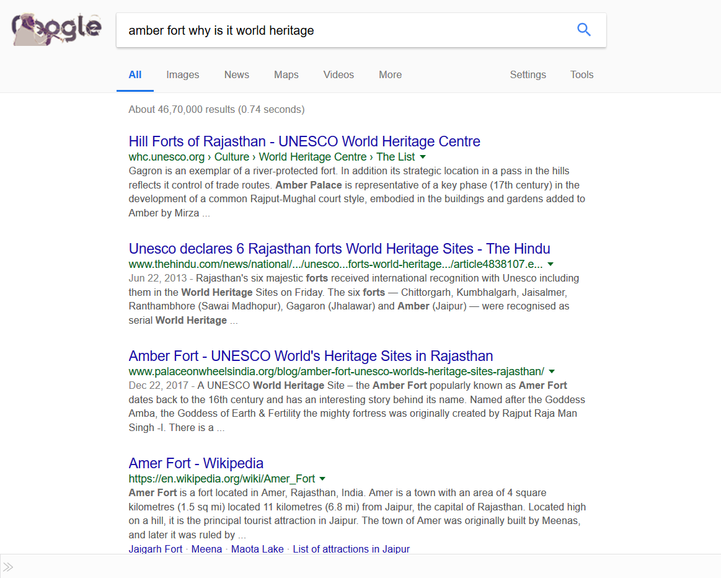
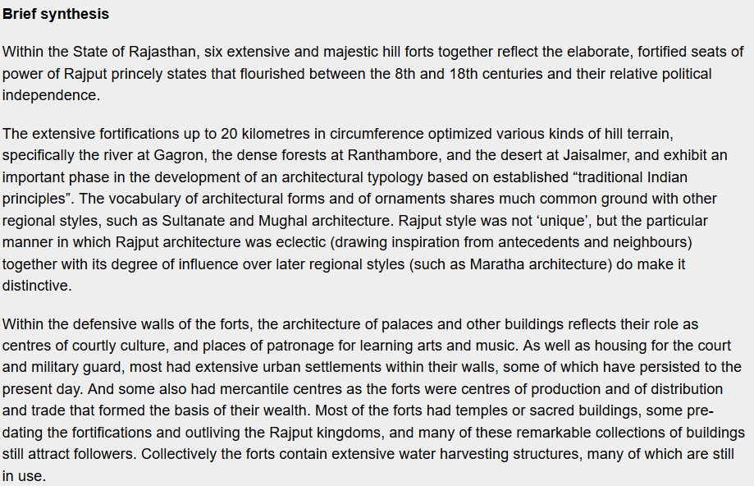
Case Study/ System Analysis
Ordinary Google search
Information as from our approach

Slide 11
Scalability
Hospital Indoor Navigation and Guidance System
University Guidance Systems
Airports Guidance System
Shopping Mall Guidance System

Slide 12

Presented by: - Amrit Ganjoo Vardan S.Jai Sukh Paul Singh

Slide 13

Travel The Smarter Way

